Slide 1

1.30pm, 27 October, Incremental Group

Slide 2
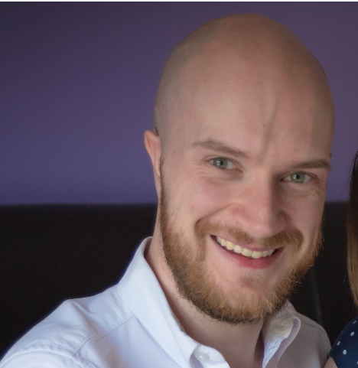
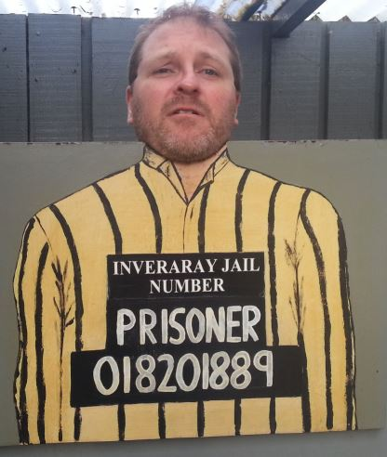




ABOUT US
Craig
Porteous
Paul
Broadwith
Data Engineer @ Incremental Group
Worked in BI with the Microsoft stack for more than 10 years.
SQL Glasgow UG co-leader. SQLGLA Creator.
Senior Technical Engineer @ Chocolatey Software
25 years in IT in the defence, government, financial services and nuclear industry sectors.
Scottish PowerShell & DevOps User Group Founder.
https://craigporteous.com
@cporteous
https://github.com/cporteou
https://www.linkedin.com/in/craigporteous/
pauby.com
@pauby
github.com/pauby
linkedin.pauby.com
Notes:
Feel free to interrupt us at any point with questions.

Slide 3
HACKTOBERFEST REGISTER
https://hacktoberfest.digitalocean.com
Notes:
T10

Slide 4
CONTRIBUTORS GUIDE
Commonly called CONTRIBUTE.md
Notes:
T10

Slide 5
RAISE AN ISSUE
Notes:
T10

Slide 6
FORK
Can only be done from the GitHub page
Notes:
T10

Slide 7
CLONE
> git clone https://github.com/rishabh-bansal/Make-a-Pull-Request
Notes:
T10

Slide 8
BRANCH
> git checkout –b my-first-pr
Notes:
T10

Slide 9
MAKE YOUR CHANGES
Notes:
T10

Slide 10
PUSH YOUR CHANGES
> git push –-set-upstream origin my-first-pr
Notes:
T10

Slide 11
MAKE YOUR PR
Can only be done from the GitHub page
Notes:
T10

